Slide 1
Wind, Are You In?

Slide 2
Team Intro

Slide 3
AGENDA
01
02
03
04
05
06
Team Intro
Data Intro
Hydro vs Wind
On or Off?
Recommendations
Wind Market

Slide 4
Introduction
02

Slide 5
Introduction
The Dataset:
Features: 26
Rows: 70,809 (Filtered: 743)
Wind Turbine Dataset and EIA Dataset 2022

Slide 6
Hydro vs Wind
03

Slide 8
US Comparison
Hydro vs Wind
Hydro
Wind
Power Plants
Power Plants
Avg Net
Avg Net
Energy
Hydroelectric Power
Wind Turbine
1,435
1,242
198.80K MW
272.00K MW

Slide 9
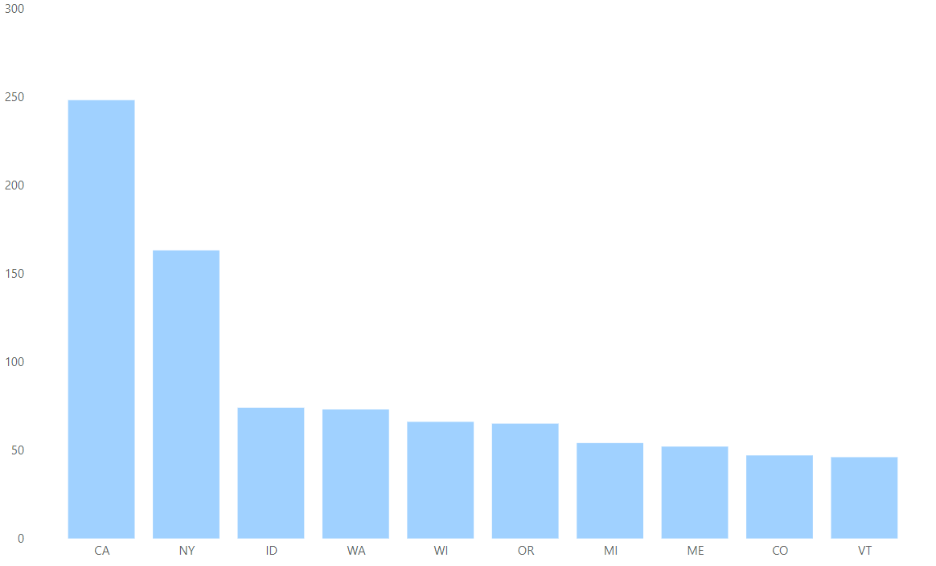
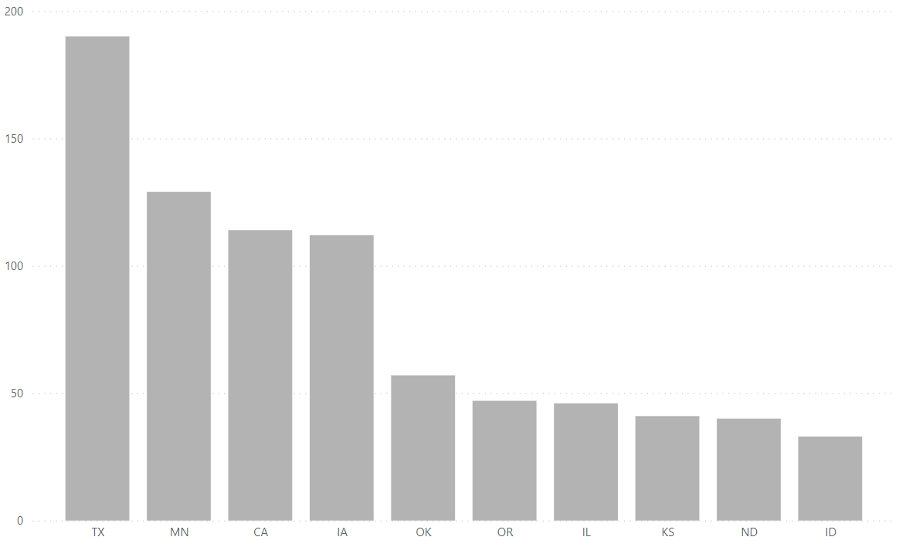
States
Hydro vs Wind
Hydro
Wind
Energy
Hydroelectric Power
Wind Turbine

Slide 10
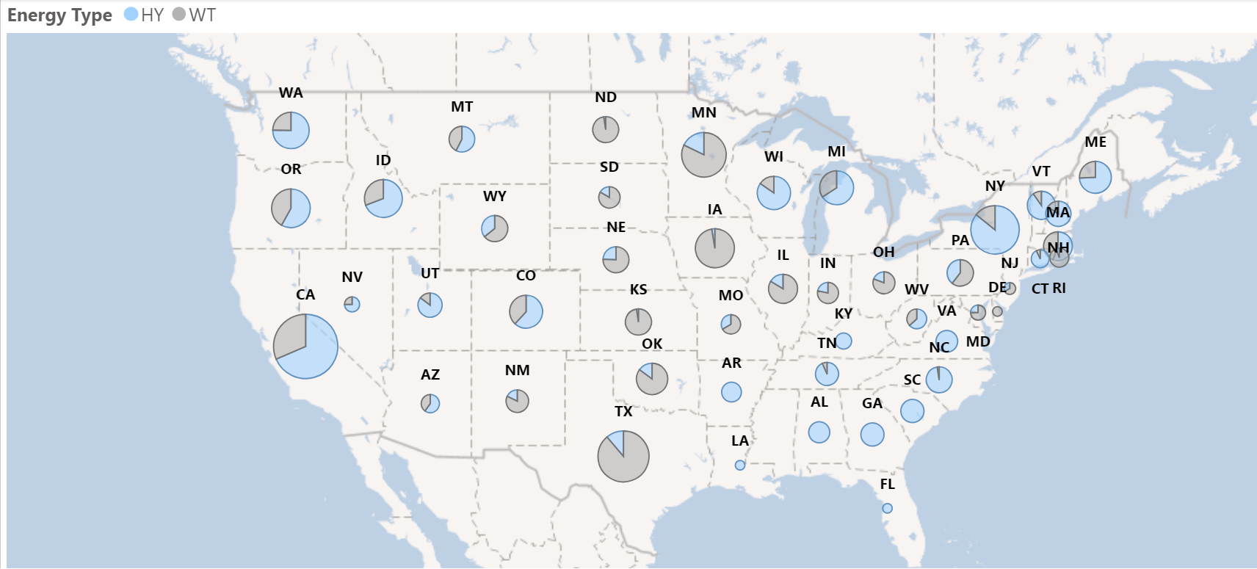

Slide 11
Net Generated
Wind | Hydro
338M mw | 285M mw

Slide 12
On or Off?
04

Slide 13
Onshore
Advantages | Disadvantages
Less Expensive | Varying Wind Speeds
Shorter Cables | Potential Wind Blockages
Quick Installation | Intermittent Energy
Low Impact On Surroundings | Visual & Sound Factors

Slide 14
Offshore
Advantages | Disadvantages
More Energy Generated | Higher Cost
More Wind Consistency | Maintenance & Repairs
Less Visual Impact | Noise & Visbility
Bigger Turbines | Less Local Jobs

Slide 15
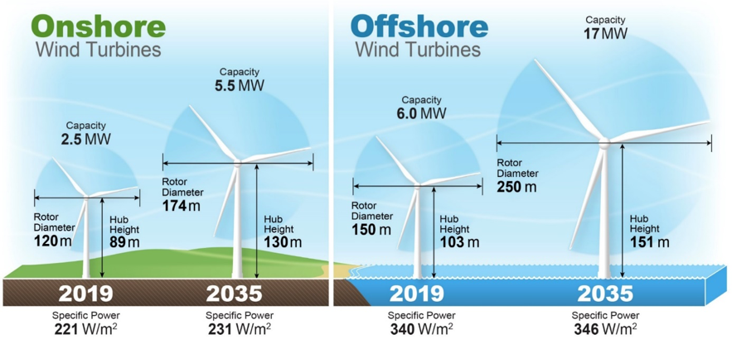
Future Looking Green!

Slide 16
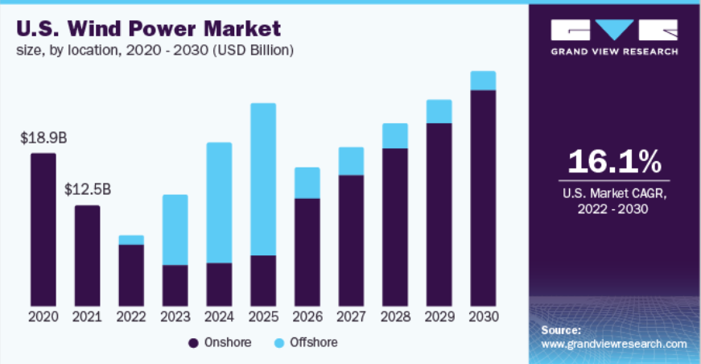

Slide 17
Wind Turbine Market
05

Slide 18
Annual Capacity
(2022, GW)
China | 37.6
United States | 8.5
Brazil | 4.1
Germany | 2.7
Sweden | 2.4
Finland | 2.4
France | 2.1
India | 1.8
United Kingdom | 1.7
Spain | 1.7
Rest of World | 12.4
TOTAL | 77.5
Cumulative Capacity
(end of 2022, GW)
China | 365
United States | 144
Germany | 67
India | 42
Spain | 30
United Kingdom | 28
Brazil | 26
France | 21
Canada | 15
Sweden | 15
Rest of World | 153
TOTAL | 906

Slide 19
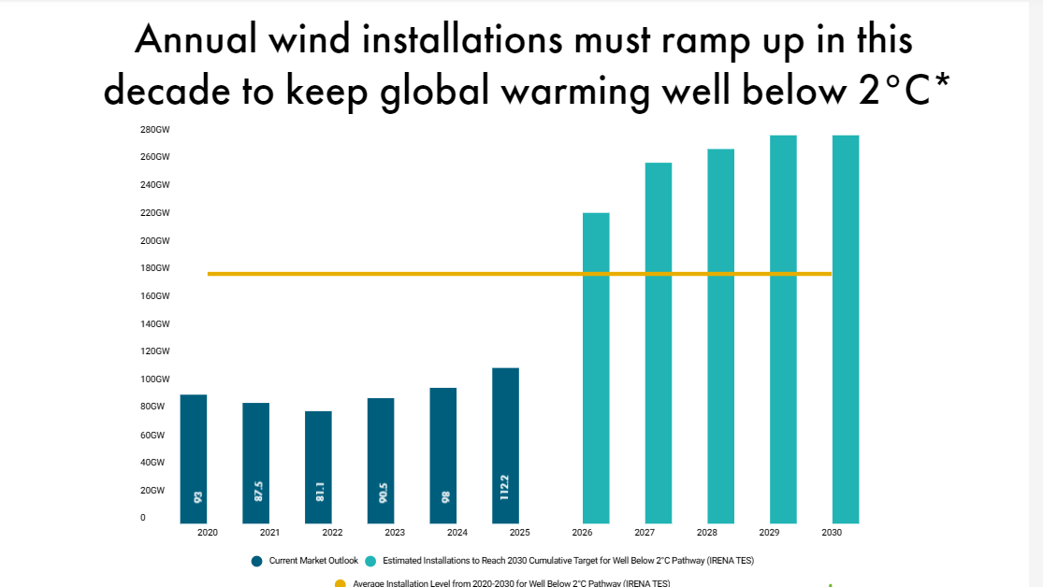

Slide 20
US Turbines
06

Slide 21
Date Range
Power Plants
Total Turbines
2010 - 2022
743
39,000

Slide 22
TEXAS!
Texas has the 23.5% of the total wind turbine power plants in the US, with a whopping 9477 turbines!

Slide 23
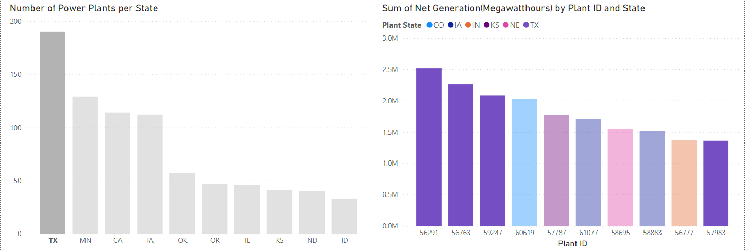

Slide 24
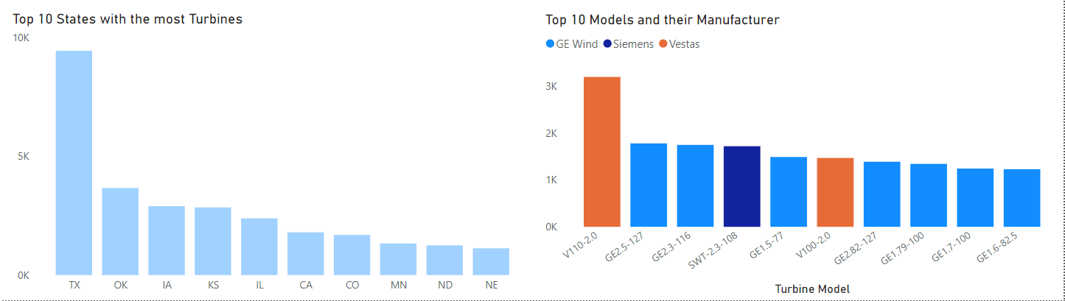

Slide 25
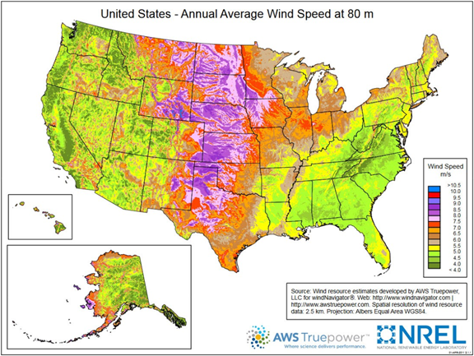

Slide 26
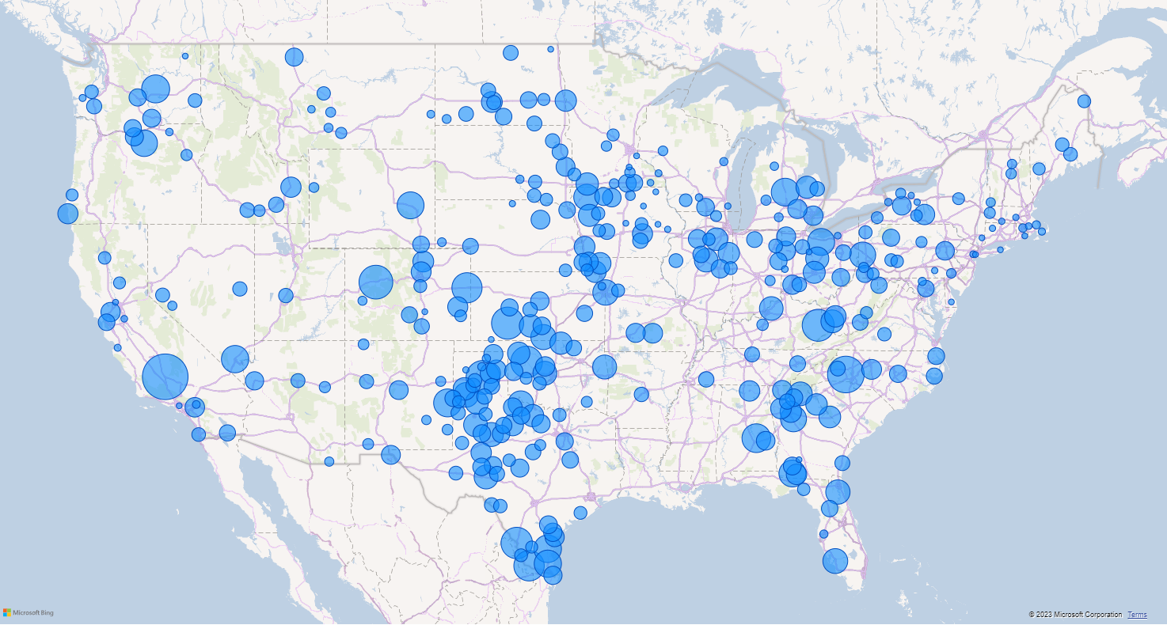

Slide 27
Recommendations
07

Slide 28
Our Recommendations
Onshore
Texas
GE2.5-127
Onshore wind turbine is the future, it is aligned with the predictions and is cost effective
Large land, large opportunities. Texas and other midwest states are recommended
Going for the GE Wind’s 2018 module is the way to go. It is worth its cost and is in high demand recently

Slide 29
$1.3 M x 2.5 = $3.25 M
+$45 K
Total = $3.3 M
Per Wind Turbine
For maintenance and installation

Slide 30
What does that mean?
Let’s do more math:
The average Texas wholesale price for electricity is $35 per megawatt-hour (MWh).
That is $840 dollars per day.
That will be $306,600 per year.
In the long run, you can cover the cost in around 10 years only!

Slide 31
Conclusion
Efficient
Economic
Environmental
Cost Effective
Texas
Weather Friendly
Future Aligned
Investment

Slide 32
—Ed Begley, Jr.
“The two most abundant forms of power on earth are solar and wind, and they’re getting cheaper and cheaper.”

Slide 33
Thanks!
Do You Have Any Questions?

